Slide 1
MA1506 Mathematics II
Chapter 6
Linear Transformation

Slide 2
6.1 What is a Linear Transformation
In this chapter, transformations are mappings (rules)
that send vectors to vectors
Linear transformation T further satisfies

Slide 3
Examples
6.1 What is a Linear Transformation
Identity transformation is linear
Check
Let D be the transformation
D is linear
Check

Slide 4
Example
6.1 What is a Linear Transformation
Given
is 2-dim vector (2x1 matrix)
Define T
= multiplication of matrices
Then T is a linear transformation

Slide 5
6.2 Linear transformations and matrices
Every vector u in 2-D space can be represented by
Let T be a linear transformation defined in 2-D space.
Then
just need to know

Slide 6
6.2 Linear transformations and matrices
Every vector u in 3-D space can be represented by
Let T be a linear transformation defined in 3-D space.
Then
just need to know

Slide 7
Example: Given
6.2 Linear transformations and matrices
We can find T(u). For example
T

Slide 8
6.2 Linear transformations and matrices
Next we want to show that every linear
Transformation T maps n-dim vectors to
m-dim vectors
can be represented by a Matrix A
Furthermore
Tu=Au=multiplication of matrices A and u

Slide 9
Now we shall prove the result
we just mentioned
6.2 Linear transformations and matrices
Suppose
All necessary info about T
is called Matrix of T relative to
or in
coordinates(system)
Shall prove

Slide 10
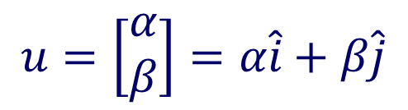
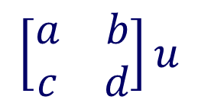
6.2 Linear transformations and matrices
Let
$$u=\left[\begin{matrix}α \\ β\end{matrix}\right]=α\hat{i}+β\hat{j}$$
$$\left[\begin{matrix}a & b \\ c & d\end{matrix}\right]u$$
We shall compute
First compute
so

Slide 11
6.2 Linear transformations and matrices
On the other hand, recall
So
Hence
(See the above equality and previous slide)
Thus T can be represented by a matrix
in coordinates(system)

Slide 12
Example
6.2 Linear transformations and matrices
Identity transformation
Hence

Slide 13
Example
6.2 Linear transformations and matrices
Linear transformation T

Slide 14
Example
6.2 Linear transformations and matrices

Slide 15
Example
6.2 Linear transformations and matrices
T : 2-D vectors
3-D vectors

Slide 16
Example
6.2 Linear transformations and matrices
T : 3-D vectors
2-D vectors

Slide 17
Dimension of linear transformation
6.2 Linear transformations and matrices
T is 2 dimensional if
T : 2-D vectors
2-D vectors
T is 3 dimensional if
T : 3-D vectors
3-D vectors

Slide 18
6.3 Determinant of linear transformation
Determinant of 2-D transformation
Recall if T maps 2-dim vectors to 2 dim
vectors then T can be represented by
2x2 matrix
We define det(T)=det( )

Slide 19
Determinant of 3-D Transformation
6.3 Determinant of linear transformation
Recall if T maps 3-dim vectors to 3-dim
vectors then T can be represented by
3x3 matrix
A
We define det(T)=det(A)

Slide 20

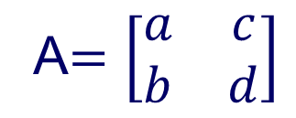
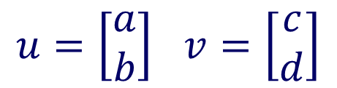
6.4 Volume and Determinant
is unit vector
Let
$$u=\left[\begin{matrix}a \\ b\end{matrix}\right] v=\left[\begin{matrix}c \\ d\end{matrix}\right]$$
Let
A$=\left[\begin{matrix}a & c \\ b & d\end{matrix}\right]$
which is the matrix
induced by vectors
u and v
Area of parallelogram
= base x height
normal multiplication
$$=|ad−bc|=|detA|$$
cross product

Slide 21
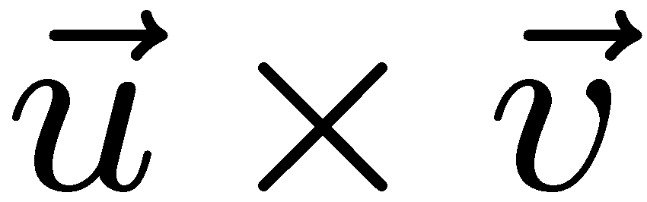
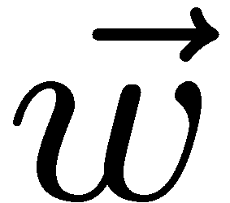
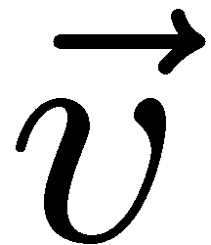

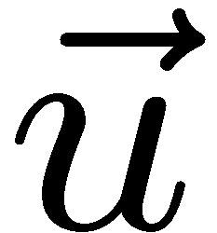

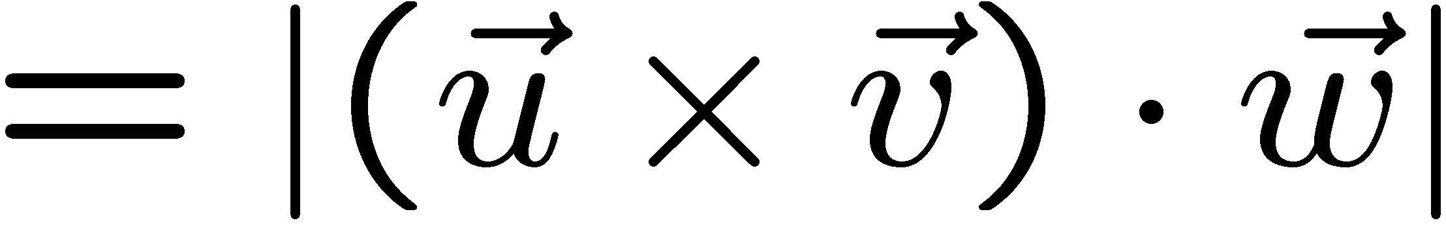
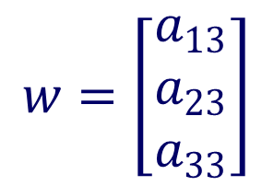
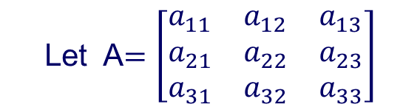
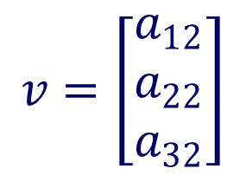
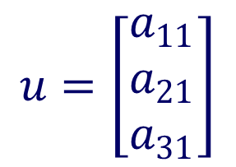

6.4 Volume and Determinant
$$u=\left[\begin{matrix}a_{11} \\ a_{21} \\ a_{31}\end{matrix}\right]$$
$$v=\left[\begin{matrix}a_{12} \\ a_{22} \\ a_{32}\end{matrix}\right]$$
$$w=\left[\begin{matrix}a_{13} \\ a_{23} \\ a_{33}\end{matrix}\right]$$
Let A$=\left[\begin{matrix}a_{11} & a_{12} & a_{13} \\ a_{21} & a_{22} & a_{23} \\ a_{31} & a_{32} & a_{33}\end{matrix}\right]$
vol of parallelepiped
= base area x height
$$=|detA|$$
Proof omitted

Slide 22
6.5 Properties of linear transformation
Suppose transformation T is linear. Then
T(0)=T(0+0)=T(0)+T(0)
0=zero vector
Hence T(0)=0 (Property 1)
One to one (non–singular ) linear transformation
A transformation T is said to be one to one if
it never maps distinct vectors to the same vector
i.e., T(u)=T(v), then u=v

Slide 23
6.5 Properties of linear transformation
Property 2: Let T be a linear transformation.
Then the following properties are equivalent:
T is 1-1
If T(u)=0, then u=0=zero vector, i.e., only
one vector maps to zero vector, that vector is zero
Proof:
(1) implies (2)
Suppose T(u)=0. We know that T(0)=0
By (1), u=0
(2) implies (1)
Suppose T(u)=T(v). Then T(u-v)=0. By (2), u-v=0

Slide 24
From now onwards, we only consider linear transformations T from n-dim space to n-dim space.
6.5 Properties of linear transformation
We know that T can be represented by a
square matrix A and Tu=Au. Here Au is
the multiplication of two matrices.
So properties of T can be induced from
properties of the square matrix
For example T(0)=0 (Property 1). It is clear
since A0=0

Slide 25
6.5 Properties of linear transformation
Suppose T=nxn matrix A.
Then properties of T can be induced
from properties of A
From Chapter 5,Section 5.5, we know that
System of linear equations AX=B
has unique solution X , for any given n-dim vector B,
iff det(A) not zero
Hence if det(A) not zero, then T is 1-1(unique soln)
and onto (has soln)

Slide 26
Example: Non Singular (1-1)Transformation
6.5 Properties of linear transformation
So is 1-1 linear transformation
from 2-dim space onto 2-dim space

Slide 27
T is not 1-1 ( is singular)
6.5 Properties of linear transformation
Suppose linear transformation T=nxn matrix A
and det(A)=0
Then from Chapter 5, Section 5.5, we know that
system of linear equations AX=0
has infinitely many solutions X
In other words,
TX=0 has infinitely many solutions X
Hence T maps
many nonzero vectors to zero vector
So T is not 1-1(is singular)

Slide 28
Rank
6.5 Properties of linear transformation
A transformation T from 3-D to 3-D has ONLY three cases
Case1: det(T) not zero
T maps 3-d space ONTO 3-d space
For this case, we say T is of rank 3
Case 2: det(T)=0
Subcase 1
T maps 3-d space ONTO a plane
For this case,
we say T is of rank 2
Example
Why? see
slide 33

Slide 29
Rank (cont.)
6.5 Properties of linear transformation
Subcase 2
T maps 3-d space ONTO a line
For this case, we say T is of rank 1
Example
Why? See slide 34

Slide 30


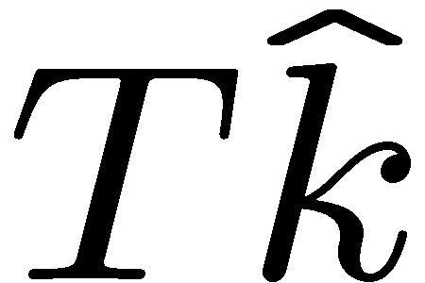

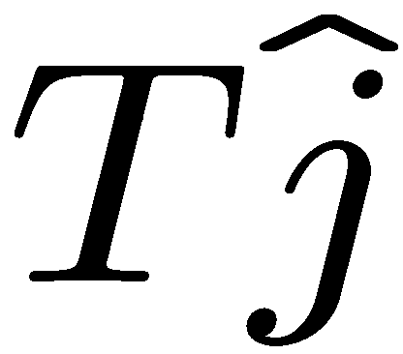
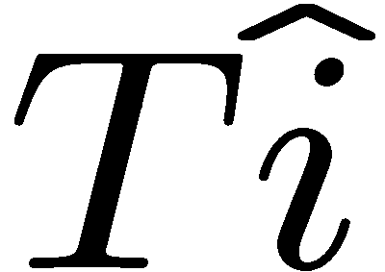
Rank 3: det(T) non zero
6.5 Properties of linear transformation
T maps 3-d space ONTO 3-d space
no direction destroyed
Image still 3-d space

Slide 31
Rank 2: det(T) = 0
6.5 Properties of linear transformation
T maps 3-d space ONTO a plane
1 direction destroyed No k direction, image is a plane
Example

Slide 32
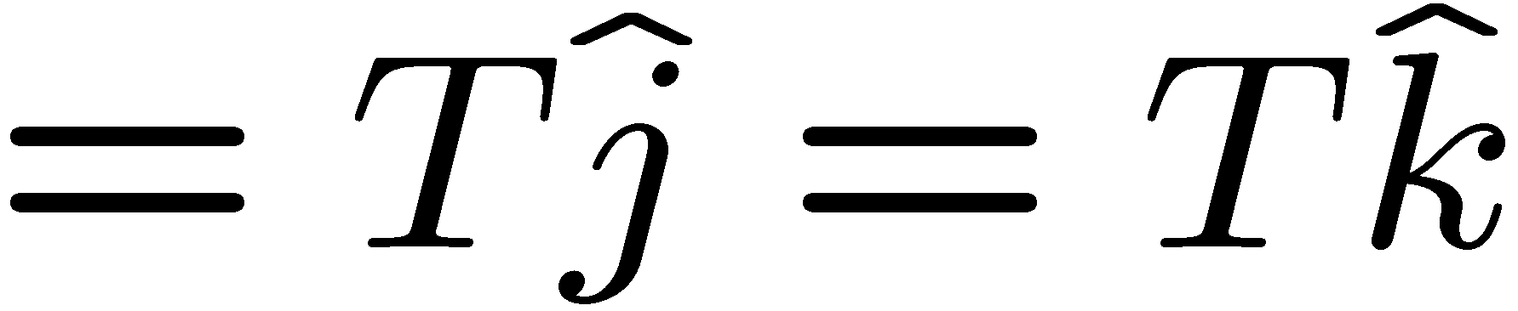
Rank 1: det(T) = 0
6.5 Properties of linear transformation
T maps 3-d space ONTO a line
2 directions destroyed
Image is a line
Example

Slide 33
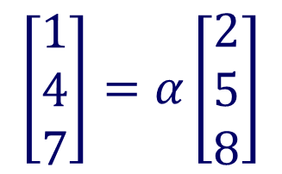
6.5 Properties of linear transformation
Example
The det of this matrix is zero
It maps 3-d space ONTO a plane. why?
Since the image is either a plane or a line,
see two subcases.
The image is not a line, so it should be a plane
$$\left[\begin{matrix}1 \\ 4 \\ 7\end{matrix}\right]=α\left[\begin{matrix}2 \\ 5 \\ 8\end{matrix}\right]$$
If it is a line then
for some α
It is not possible

Slide 34
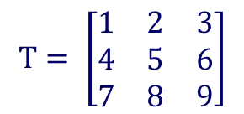
Rank 2: det(T) = 0
Example
6.5 Properties of linear transformation
$$T= \left[\begin{matrix}1 & 2 & 3 \\ 4 & 5 & 6 \\ 7 & 8 & 9\end{matrix}\right]$$
Det T=0
has no solution
(1,2,4) not on the plane
(1,2,3) on the plane
Image is a plane
has solution in fact infinitely many solutions

Slide 35
6.5 Properties of linear transformation
To understand the previous example,
recall
(1) if det(A)=0, then AX=0 has
infinitely many solutions
(2) If det(A)=0, then AX=B has two cases:
AX=B has NO solution or
AX=B has infinitely many solutions
(Why infinitely many solutions, see
next slide)

Slide 36
6.5 Properties of linear transformation
If det(A)=0, then AX=0 has nonzero solution
say .
Then
So if det(A)=0, then AX=0 has infinitely many nonzero solutions.
Now suppose AX=B has a solution, say
Then
Hence

Slide 37
6.5 Properties of linear transformation
The above holds for any real number and is nonzero.
So if det(A)=0 and AX=B has a solution, then it has infinitely many solutions

Slide 38
Why infinitely many solutions?
6.5 Properties of linear transformation
α any real number

Slide 39
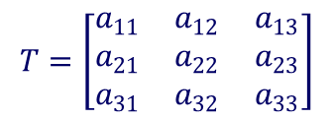
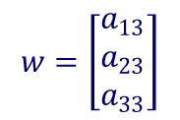
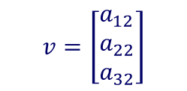
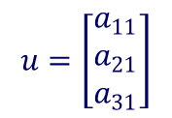
We shall discuss this matrix again in T9 Q 6
6.5 Properties of linear transformation
How to check that the vector [1,2,3] is on
the plane, vector [1,2,4] is not on the plane ?
Recall if the plane is generated by two vectors
u and v ,then (uxv).w=0 iff vector w is on the plane
$$u=\left[\begin{matrix}a_{11} \\ a_{21} \\ a_{31}\end{matrix}\right]$$
$$v=\left[\begin{matrix}a_{12} \\ a_{22} \\ a_{32}\end{matrix}\right]$$
uxv
v
(uxv).w=0 iff detT=0
w
$$w=\left[\begin{matrix}a_{13} \\ a_{23} \\ a_{33}\end{matrix}\right]$$
┐
u
$$T=\left[\begin{matrix}a_{11} & a_{12} & a_{13} \\ a_{21} & a_{22} & a_{23} \\ a_{31} & a_{32} & a_{33}\end{matrix}\right]$$
End of Chapter 6

